Slide 1


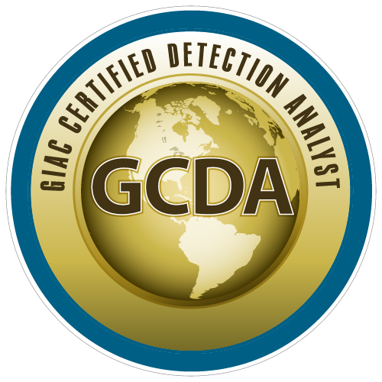

Tactical Detection and Data Analytics Summit
Save the Date: December 4-11 Scottsdale, Arizona
sans.org/summit
SEC599 – Defeating Advanced Adversaries
SEC530 – Defensible Security Architecture
SEC555 – SIEM with Tactical Analytics
SEC511 – Continuous Monitoring & Security Operations
SIEM NetWars
SUMMIT
Dec. 4-5
TRAINING
Dec. 6-11
sans.org/summit
Notes:
Drag Picture and Send to Back

Slide 2
SEC555
Presentation based on SEC555: SIEM with Tactical Analytics
More Bad Data
Justin Henderson and John Hubbard

Slide 3


About Us
Justin Henderson
SEC555 Author / SEC455 and SEC530 Co-Author
GSE #108 / Cyber Guardian Blue + Red / 60 certs
Owner of H & A Security Solutions
Twitter: @SecurityMapper
John Hubbard
SEC555 / SEC511 Instructor
SEC450 Author / SEC455 Co-author
SOC Lead, GMON | GREM | GPEN
Twitter: @SecHubb

Slide 4
Welcome!
A copy of this talk is available at: https://github.com/HASecuritySolutions/presentations
More free stuff: https://github.com/HASecuritySolutions

Slide 5

SIEM Implementation
So you bought a SIEM...
You may have expected instant detection capabilities
You may have paid for services to fast track this
Yet many SIEM implementations focus too much on data collection
Not use ... big distinction!!

Slide 6
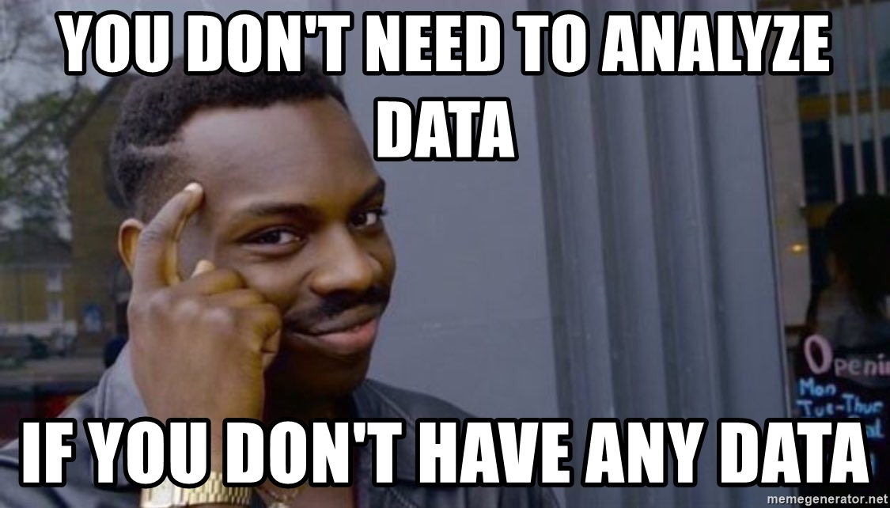
What to Collect / What to Analyze
Without experience, it is difficult to choose event sources
The choices seem endless
Compliance adds confusion
The list grows daily
Operating Systems
Switches
Firewalls
IDS/IPS
HIPS
Proxy
Databases
Hypervisors
Scripts
FIM
Endpoint Security Suites
Network Security Monitoring
Application Logs
Vulnerability Scanners

Slide 7
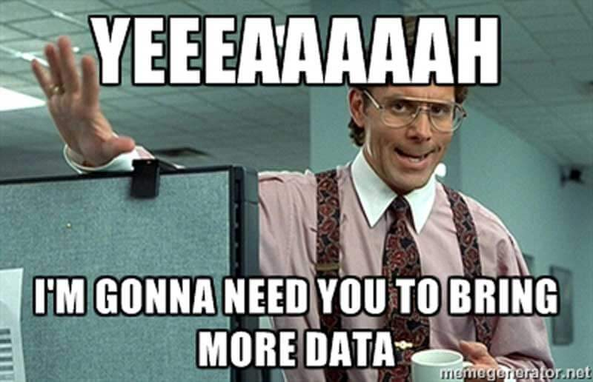
Going Tactical
Windows logs
PowerShell
DriverFramework
WMI
Sysmon
Network
DNS, HTTP, SSL, SMB, Kerberos

Slide 8
Data-Gathering Strategies
Do you really need everything? What about compliance?
Three main strategies for data gathering:
Input-driven¹ – Collect everything
Output-driven² – Collect only what you know you need
Hybrid – Collect everything but constantly trim
Notes:
[1] http://blogs.gartner.com/anton-chuvakin/2012/09/24/on-output-driven-siem/
[2] Ibid.

Slide 9

Input-Driven Strategy (The Hoarder’s Approach)
Collecting everything allows for historical analysis of all data
PROs
You have it
CONs
Hard to search through
Slow and expensive
Can you find the broccoli and cheese soup can?

Slide 10
Output-Driven Strategy
Focusing on only what you know you need makes deployment and analysis easier
PROs
Least expensive approach
Easier rollout and improved search performance
CONs
You are likely to miss something you did not know you needed

Slide 11
Hybrid Strategy
May be simpler to collect everything, then trim the noise
PROs
Have historical data even if you are not sure you need it
Significantly cheaper to maintain than input-driven
CONs
Requires ongoing maintenance and tuning

Slide 12
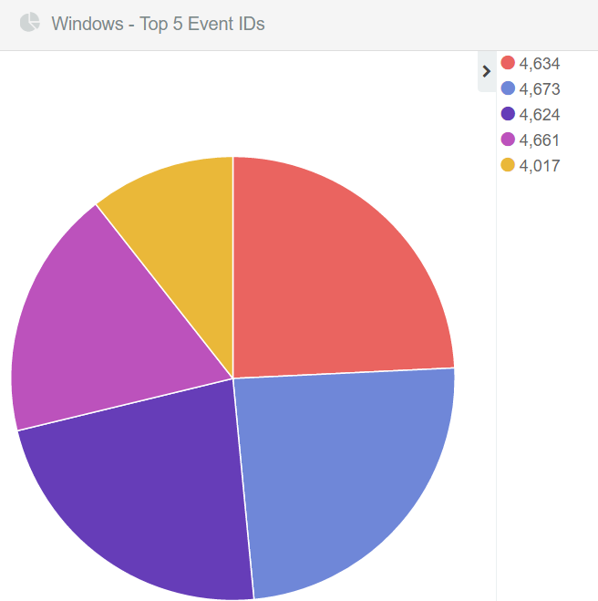
Finding Noise
Regularly looking for noise and eliminating it:
Increases performance
Increases analysis speed
Decreases costs
Is easy to do…
Notes:
Finding Noise
Regularly looking for logs that are noise and eliminating them is an easy, quick win. This simple process will increase the performance of searches within the SIEM. After all, less data means lower hardware utilization. This alone will improve an analyst’s speed, but so will the fact that there are fewer logs to have to filter through.
Eliminating noise is something that should be done regardless of collection strategy. It is easy to do and can save lots of money while providing many other benefits. This slide shows a simple graph based on Windows logs.

Slide 13
Tactical vs. Total
All-inclusive
Tactical
Desktops
Servers
Servers
Desktops

Slide 14
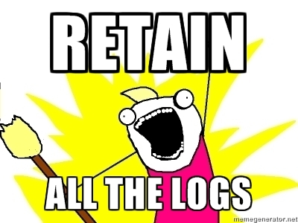
Compliance
Compliance is a costly and confusing beast
Example: PCI DSS Requirement 10
Log all "in scope" assets
Must have 1-year retention
3 months of accessible logs
Above is straightforward, what must be logged is not
"Track and monitor all access to network resources and cardholder data" <- Does not mean log everything

Slide 15


Do Things with Purpose
Why do we collect logs? To analyze them...
Why do we analyze them? To catch odd/bad activity...
So then what should you collect?

Slide 16
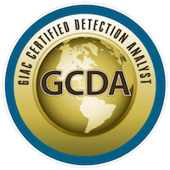
Summary
SIEM is just a tool (an awesome one)
Yet tools are ineffective when not used properly
Consider SEC555: SIEM with Tactical Analytics
Focus is on proper data sources, enrichment, and detection
Consider SEC450: Blue Team Fundamentals
Focus is on SOC workflow, tools, and data analysis
Consider SEC455: SIEM Design and Implementation
Two-day course on deploying an open-source SIEM

Slide 17
Tactical Detection and Data Analytics Summit
Save the Date: December 4-11 Scottsdale, Arizona
sans.org/summit
SEC599 – Defeating Advanced Adversaries
SEC530 – Defensible Security Architecture
SEC555 – SIEM with Tactical Analytics
SEC511 – Continuous Monitoring & Security Operations
SIEM NetWars
SUMMIT
Dec. 4-5
TRAINING
Dec. 6-11
sans.org/summit
Notes:
Drag Picture and Send to Back

